Slide 1
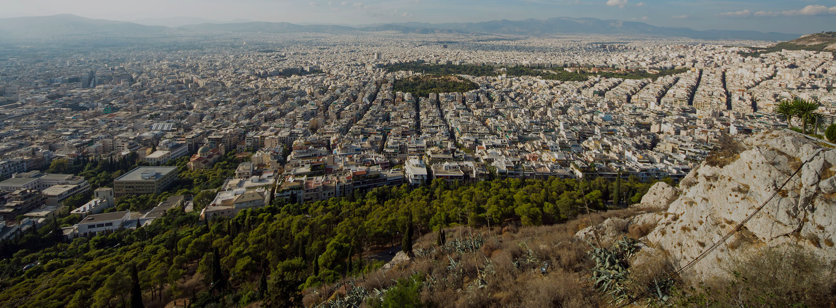
Presentation Title Presenter Name Affiliation
7th -9th JUNE
ATHENS
GREECE

